Slide 1
A closer look at methods and classes

Slide 2
Agenda
Overloading Methods
Automatic Type Conversion
Overloading Constructors
Using objects as Parameters
Passing objects in constructor
Argument passing
Returning objects
Access control
Using static
Introducing final
Nested and inner classes

Slide 3
Overloading Methods
Polymorphism - Means one entity having many (poly) forms (morph)
We can have multiple methods with the same name in the same class, i.e. Method Overloading
In java it is possible to define two or more methods within the same class that share the same name, as long as their parameter declarations are different.
When this is the case the methods are said to be overloaded and the process is referred to as method overloading

Slide 4
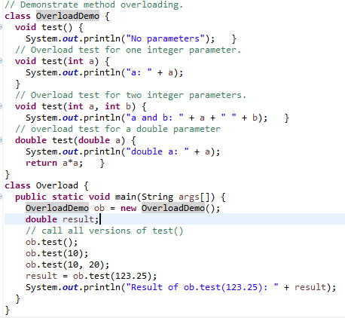

Overloading Methods

Slide 5
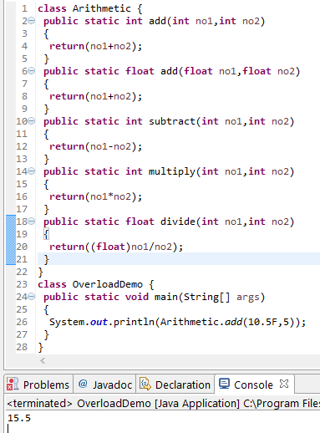
Overloading Methods

Slide 6
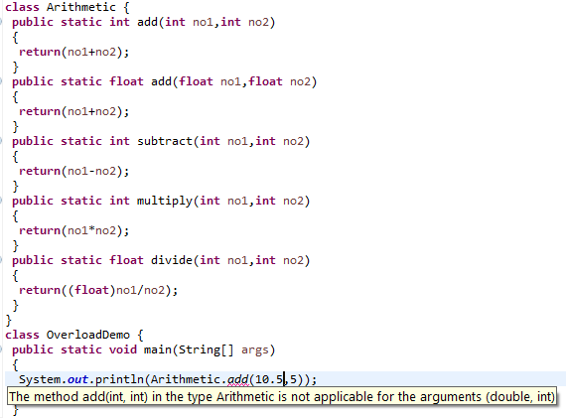
Overloading Methods

Slide 7
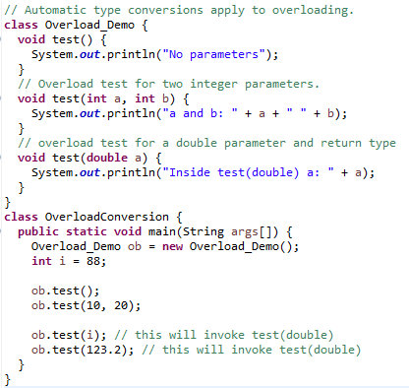

Automatic Type Conversion
When an overloaded method is called, Java looks for a match between the arguments used to call the method and the method’s parameters
However, this match need not always be exact

Slide 8
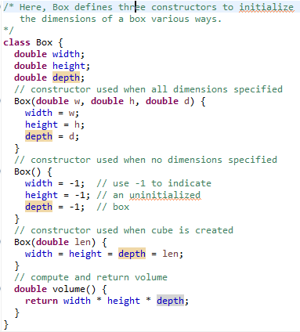
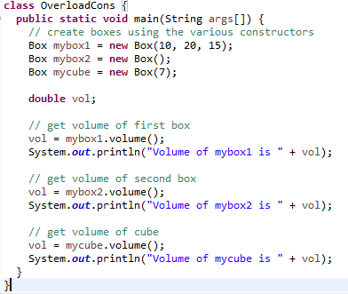

Overloading Constructors

Slide 9
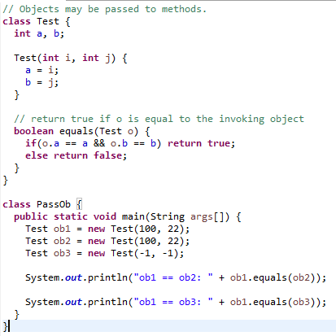

Using Objects as Parameters

Slide 10
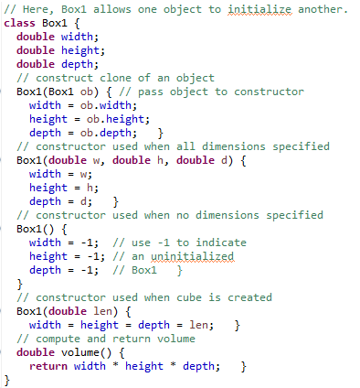
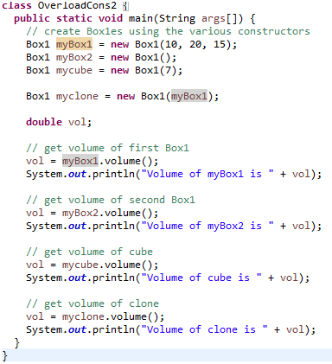

Passing objects in constructor

Slide 11
Argument Passing
Two ways of passing arguments:
Call by value
Copies the value of an argument into the formal parameter of the subroutine.
Changes made to the parameter of the subroutine has no effect on the argument.
When you pass a primitive type to a method, it is passed by value.
Call by reference
Reference to an argument (not the value of argument) is passed to the parameter.
Changes made to the parameter will affect the argument used to call the subroutine.
When you pass an object to the method, it is effectively call-by-reference.

Slide 12
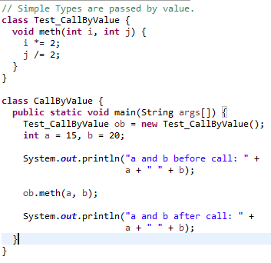

Argument Passing – Call by value
Formal Parameters
Actual Parameters / Arguments

Slide 13
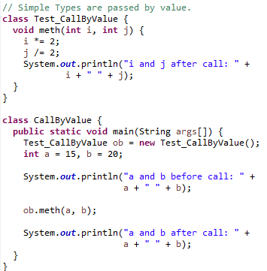

Argument Passing – Call by value
Formal Parameters
Actual Parameters / Arguments

Slide 14
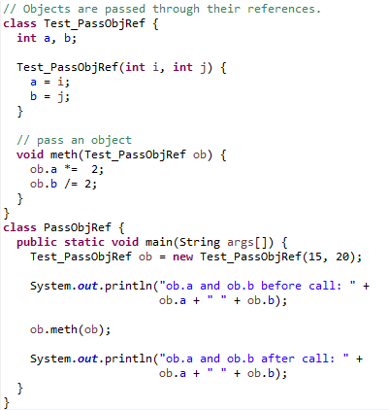

Argument Passing – Call by reference

Slide 15
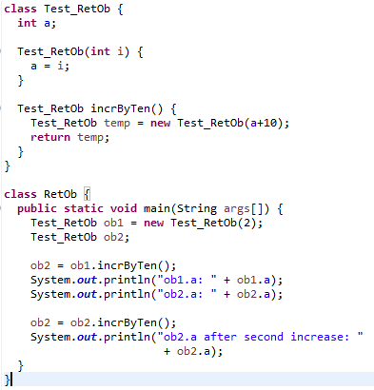

Returning Objects
A method can return object of a class.

Slide 16
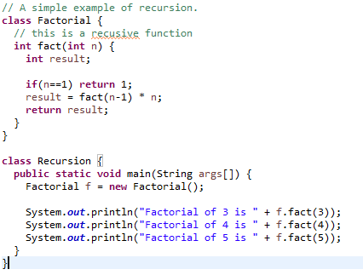

Recursion

Slide 17
Access Control
Access Control Modifiers:
Java provides a number of access modifiers to set access levels for classes, variables, methods and constructors. The four access levels are:
Visible to the package. The default. No modifiers are needed.
Visible to the class only (private).
Visible to the world (public).
Visible to the package and all subclasses (protected).
Non Access Modifiers:
Java provides a number of non-access modifiers to achieve many other functionality.
The static modifier for creating class methods and variables
The final modifier for finalizing the implementations of classes, methods, and variables.
The abstract modifier for creating abstract classes and methods.
The synchronized and volatile modifiers, which are used for threads.

Slide 18
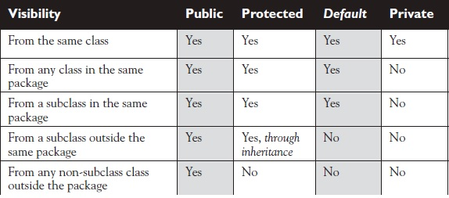
Access Control

Slide 19
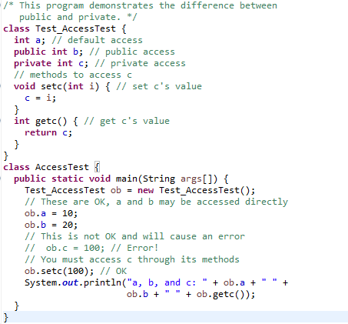
Access Control

Slide 20
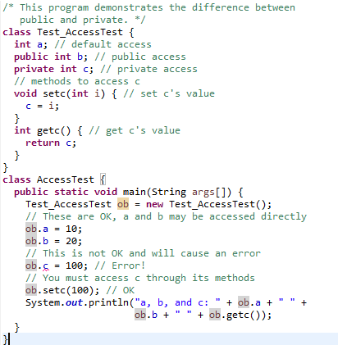

Access Control

Slide 21
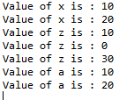
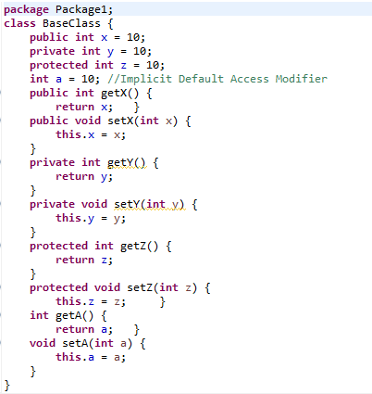
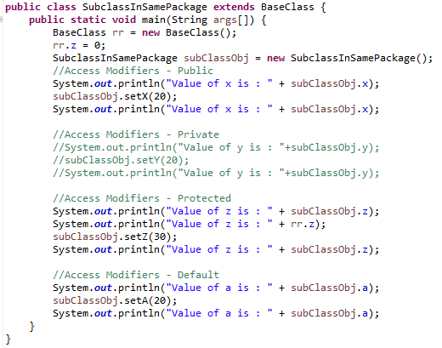
Access Control

Slide 22
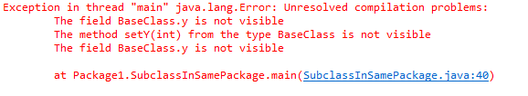
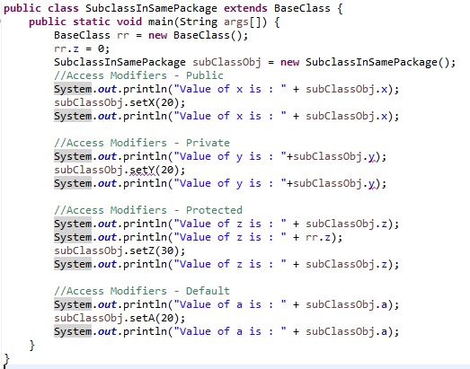
Access Control

Slide 23
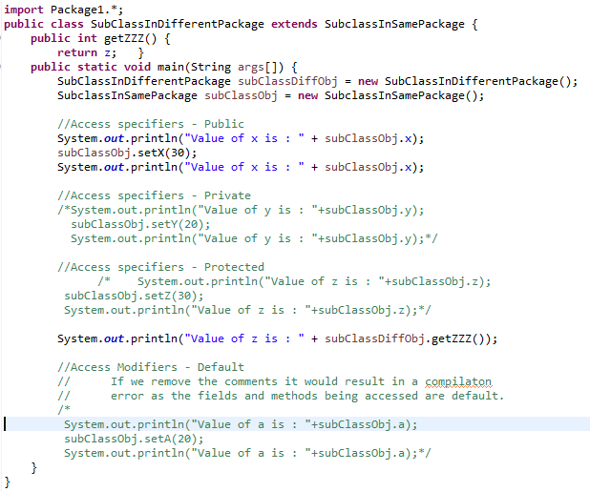

Access Control

Slide 24
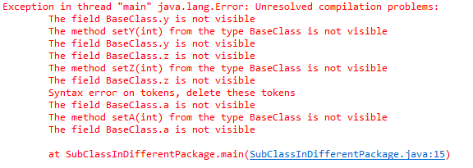
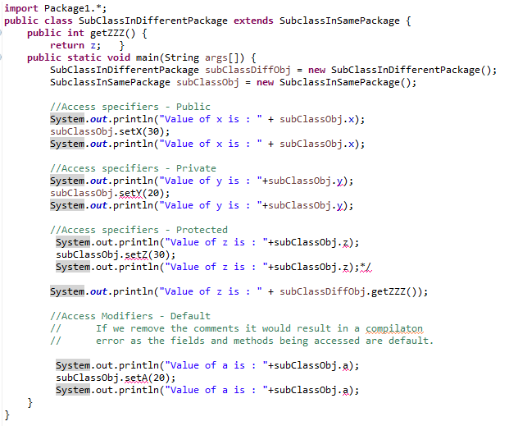
Access Control

Slide 25
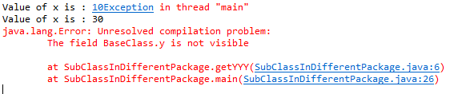
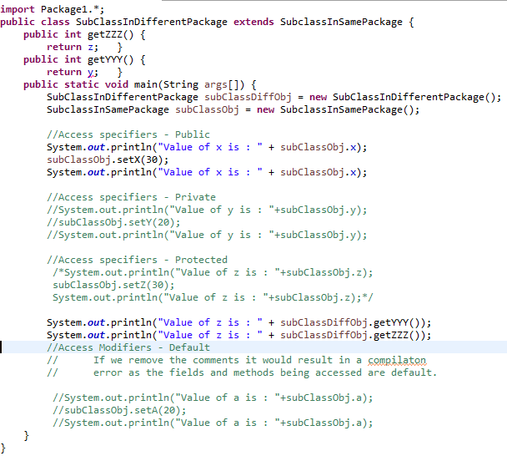
Access Control

Slide 26
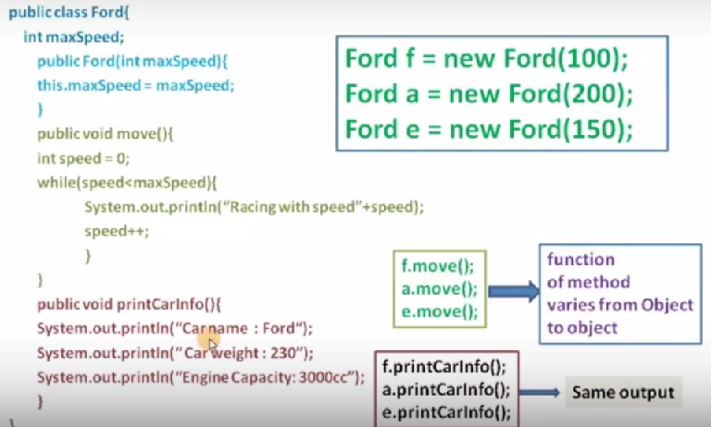

Slide 27
Using static
static keyword can be used in three scenarios:
For class variables
For methods
For a block of code
Static variables are stored in Data Segment area.
The keyword 'static' means that only one instance of a given variable exists for a class. This is often used to define constants because their values can be retrieved by invoking the class without creating an instance of it.
So if you see "Math.PI", you should recognize that there is a 'Math' object with a variable 'PI', and that there is only one variable 'PI', and that you can retrieve the value of PI by invoking the Math object without creating an instance of it.
Static variables are scoped differently than instance variables, of course, and it is important to keep in mind that the 'main' function is also static and cannot access the instance variables of any given instance of the class directly. One effect of static variables is that every instance has access to them; this is often used to keep a counter of the number of instances that exist.

Slide 28
Using static
All instances of the same class share a single copy of the static variables. Static variables are initialized to default values when the class is loaded into memory. i.e. Variables of type boolean are set to false, Numbers are set to zero, any variable that act as an object reference is set to null.
static type varName1=expr1;
Static variables are initialized when a class is loaded.
Static variables in a class are initialized before any object of that class can be created.
Static Variables in a class are initialized before any static method of the class runs.
Static variables are initialized only once and at the start of the execution during the lifetime of a class.
They cannot refer to this or super in anyway.

Slide 29
Using static
static variable
Belongs to a class
A single copy to be shared by all instances of the class
Creation of instance not necessary for using static variables
Accessed using <class-name>.<variable-name> unlike instance variables which are accessed as <object-name>.<variable-name>
static method
It is a class method
Accessed using class_name.method_name
Creation of instance not necessary for using static methods
A static method can access only other static data & methods, and not non-static members

Slide 30
Using static
Class Student {
private int rollNo;
private static int studCount;
public Student(){
studCount++;
}
public void setRollNo (int r){
rollNo = r;
}
public int getRollNo (int r){
return rollNo;
}
public static void main(String args[]){
System.out.println(“RollNo of the Student is;” + rollNo);
}
}
The static studCount variable is initialized to 0, ONLY when the class is first loaded, NOT each time a new instance is made
Each time the constructor is invoked, i.e. an object gets created, the static variable studCount will be incremented thus keeping a count of the total no of Student objects created
Which Student? Whose rollNo? A static method cannot access anything non-static
Compilation Error
30

Slide 31
Using static
static block: A block of statement inside a Java class that is executed when a class is first loaded & initialized
A class is loaded typically after the JVM starts
Sometimes a class is loaded when the program requires it
A static block helps to initialize the static data members like constructors help to initialize instance members
class Test{
static {
//Code goes here
}
}

Slide 32
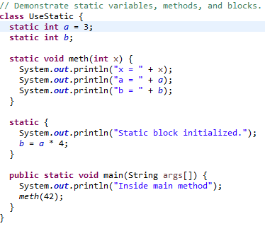

Using static
As soon as the UseStatic class is loaded, all of the static statements are run.
First, a is set to 3, then the static block executes, which prints a message and then initializes b to a*4 or 12.
Then main( ) is called, which calls meth( ), passing 42 to x. The three println( )statements refer to the two static variables a and b, as well as to the local variable x.

Slide 33
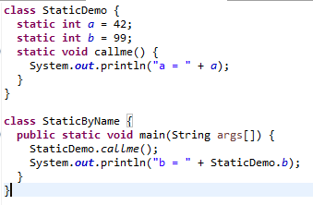

Using static

Slide 34
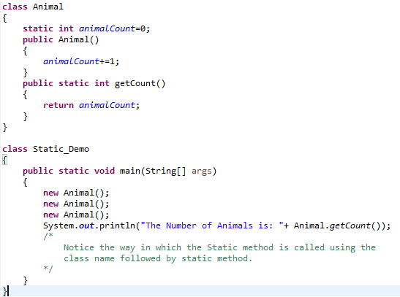
Using static

Slide 35
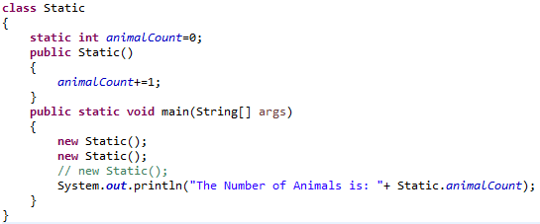
Using static

Slide 36
Using static
Members marked as static belong to the class file and not the instances.
Static variables and methods are called class members.
To access instance variables and methods, a static method should have an instance on which object members should be invoked.
Any instance can access the static variables and can change them. But, the changes will reflect for all the objects.
Understand the meaning of “public static void main(String args[])”

Slide 37
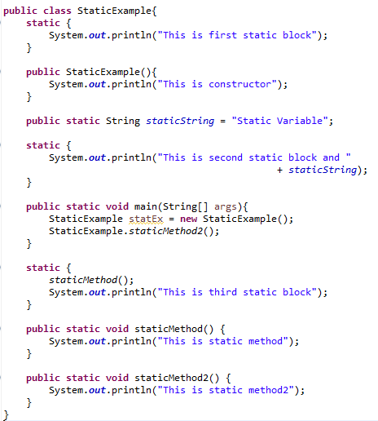

Using static

Slide 38
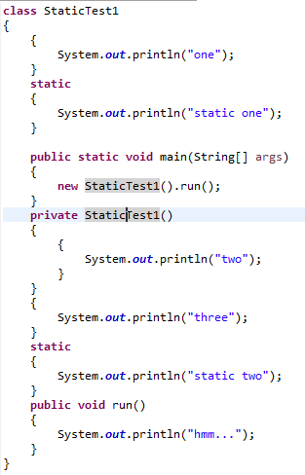
Using static

Slide 39
Introducing final
A variable can be declared as final.
Doing so prevents its contents from being modified.
This means that you must initialize a final variable when it is declared.
final int FILE_NEW = 1;
final int FILE_OPEN = 2;
final int FILE_SAVE = 3;
final int FILE_SAVEAS = 4;
final int FILE_QUIT = 5;
Subsequent parts of your program can now use FILE_OPEN, etc., as if they were constants, without fear that a value has been changed.

Slide 40
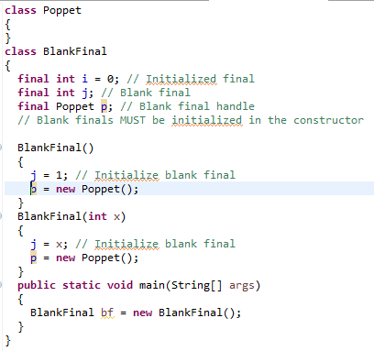
Introducing final

Slide 41
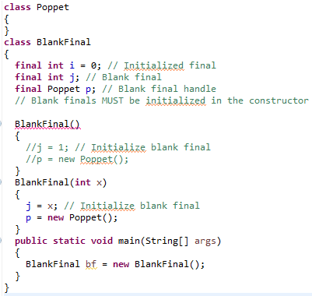

Introducing final

Slide 42
Nested and Inner Classes
Defining a class within another class, such classes are known as nested classes.
Java supports nested classes declaration
The scope of a nested class is bounded by the scope of its enclosing class
A nested class has access to the members, including private members, of the class in which it is nested. However, the enclosing class does not have access to the members of the nested class.
There are two types of nested classes, static and non-static (inner).
A static nested class is one that has the static modifier applied. Because it is static, it must access the non-static members of its enclosing class through an object.
An inner class is a non-static nested class. It has access to all of the variables and methods of its outer class and may refer to them directly in the same way that other non-static members of the outer class do
An instance of inner class can be created only within the scope of outer class. However, create an instance of inner class outside the outer class by qualifying its name with outer class, as in Outer.Inner

Slide 43
Nested and Inner Classes
class OuterClass {
//outer class members
class InnerClass {
//Inner class member
}
}
Compile the program containing innerclass as
javac OuterClass.java
It creates two separate .class files as OuterClass.class and OuterClass$InnerClass.class
Even though a non-static inner class has a separate class file created for it when the outer class is compiled, that does not mean that we can just access the inner class like any other normal class.
An inner class can not have any static members at all – and that includes “public static void main()”
The only way that we can access an inner class is by creating an actual instance of the outer class

Slide 44
Why use nested classes?
It is a way of logically grouping classes that are only used in one place:
If a class is useful to only one other class, then it is logical to embed it in that class and keep the two together. Nesting such "helper classes" makes their package more streamlined.
It increases encapsulation:
Consider two top-level classes, A and B, where B needs access to members of A that would otherwise be declared private. By hiding class B within class A, A's members can be declared private and B can access them. In addition, B itself can be hidden from the outside world.
It can lead to more readable and maintainable code:
Nesting small classes within top-level classes places the code closer to where it is used.

Slide 45
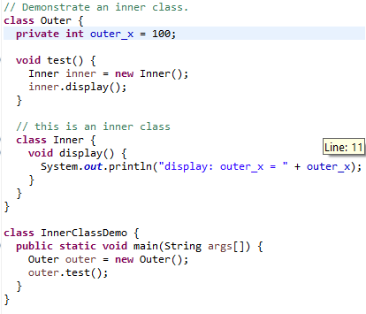

Inner Class

Slide 46
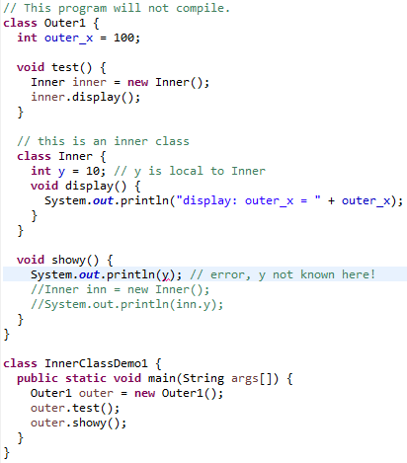

Inner Class

Slide 47
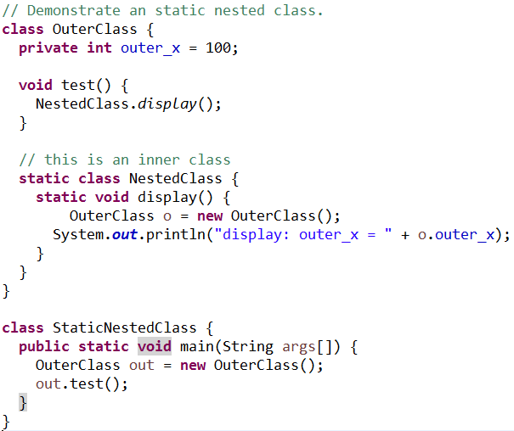
Static Nested Class

Slide 48
THANK YOU!!
ANY QUESTIONS??

